Slide 1
Cornerstone City Church Peninsula Plus Community Hoo Are Ya
3rd March 2024

Slide 2


Slide 3


Slide 4


Slide 5
Let Everything That Has Breath
CCLI Song # 2430979
Matt Redman
© 1997 Thankyou Music
For use solely with the SongSelect® Terms of Use. All rights reserved. www.ccli.com
CCLI Licence No. 33265

Slide 6
1/4
Let ev'rything that
Ev'rything that
Ev'rything that has breath
Praise the Lord
Let ev'rything that
Ev'rything that
Ev'rything that has breath
Praise the Lord

Slide 7
2/4
Praise You in the morning
Praise You in the evening
Praise You when I'm young
And when I'm old
Praise You when I'm laughing
Praise You when I'm grieving
Praise You ev'ry season of the soul

Slide 8
3/4
If we (they) could see
How much You're worth
Your pow'r Your might
Your endless love
Then surely we would
Never cease to praise

Slide 9
4/4
Praise You in the heavens
Joining with the angels
Praising You forever and a day
Praise You on the earth now
Joining with creation
Calling all the nations to Your praise

Slide 10
Praise
CCLI Song # 7213077
© Brandon Lake MusicFor Humans PublishingMaverick City PublishingCapitol CMG GenesisCapitol CMG ParagonHousefires SoundsWriter's Roof PublishingMusic by Elevation Worship Publishing
For use solely with the SongSelect® Terms of Use. All rights reserved. www.ccli.com
Note: Reproduction of this sheet music requires a CCLI Music Reproduction Licence. Please report all copies.
CCLI Licence No. 33265

Slide 11
1/12
Let everything that has breath
Praise the Lord
Praise the Lord

Slide 12
2/12
I’ll praise in the valley
Praise on the mountain
I’ll praise when I’m sure
Praise when I’m doubting

Slide 13
3/12
I’ll praise when outnumbered
Praise when surrounded
'Cause praise is the water
My enemies drown in

Slide 14
4/12
As long as I’m breathing
I’ve got a reason to Praise the Lord oh my soul
Praise the Lord oh my soul

Slide 15
5/12
I’ll praise when I feel it
And I’ll praise when I don’t
I’ll praise 'cause I know
You’re still in control

Slide 16
6/12
'Cause my praise is a weapon
It’s more than a sound
My praise is the shout
That brings Jericho down

Slide 17
7/12
As long as I’m breathing
I’ve got a reason to Praise the Lord oh my soul
Praise the Lord oh my soul

Slide 18
8/12
I won’t be quiet
My God is alive
How could I keep it inside
Praise the Lord oh my soul

Slide 19
9/12
I’ll praise 'cause You’re sovereign
Praise 'cause You reign
Praise 'cause You rose and defeated the grave
I’ll praise 'cause You’re faithful
Praise 'cause You’re true
Praise 'cause there’s nobody greater than You

Slide 20
10/12
Praise the Lord oh my soul
Praise the Lord oh my soul
Praise the Lord oh my soul
Praise the Lord oh my soul
I won’t be quiet
My God is alive
How could I keep it inside

Slide 21
1 1/12
I won’t be quiet
My God is alive
How could I keep it inside
I won’t be quiet
My God is alive
How could I keep it inside
Praise the Lord oh my soul

Slide 22
12/12
Let everything that has breath
Praise the Lord
Praise the Lord

Slide 23
Something About That Name
CCLI Song # 7167032
Anne Wilson | Colby Wedgeworth | Ethan Hulse
© Capitol CMG Genesis; Capitol CMG Paragon; Jacobs Story Music; Wedgeworth Publishing; Be Essential Songs; EGH Music Publishing
For use solely with the SongSelect® Terms of Use. All rights reserved. www.ccli.com
CCLI License # 33265

Slide 24
1/4
Sweeter than the morning
Or the sound of the rain
From the mouth of the preacher
And the sinner the same
Tender as a whisper
But loud in it's refrain
May it hang on my lips for the rest of my days

Slide 25
2/4
There is something about the name of Jesus
It sounds like forgiveness sounds like amazing grace
It beckons my soul to sing forever
There's just something about that name

Slide 26
3/4
We pray it over family
When we rise and when we sleep
We speak it over sorrow
And the soul is given peace
We'll sing it in the famine
Or in prosperity
May we never forget that He is all that we need

Slide 27
4/4
There is still no other name
You still have the power to save
You can empty any grave
Forever Jesus it's Your name

Slide 28
There Is No Other Name
Dele Olajide

Slide 29
1/2
There is no other name like Jesus
There is no other name like the name of the Lord
There is no other name like Jesus
There is no other name like the name of the Lord

Slide 30
2/2
At his name, demons flee
By his name, we are healed
Through his name, salvation comes to all
There is no other name like our God

Slide 32
King Of Kings Majesty
CCLI Song # 1581778
Jarrod Cooper
© 1996 Sovereign Lifestyle Music
For use solely with the SongSelect® Terms of Use. All rights reserved. www.ccli.com
CCLI Licence No. 33265

Slide 33
1/3
King of kings majesty
God of heaven living in me
Gentle Saviour closest friend
Strong deliv'rer beginning and end
All within me falls at Your throne

Slide 34
2/3
Your majesty I can but bow
I lay my all before You now
In royal robes I don't deserve
I live to serve Your majesty

Slide 35
3/3
Earth and heav'n worship You
Love eternal faithful and true
Who bought the nations ransomed souls
Brought this sinner near to Your throne
All within me cries out in praise

Slide 37


Slide 38
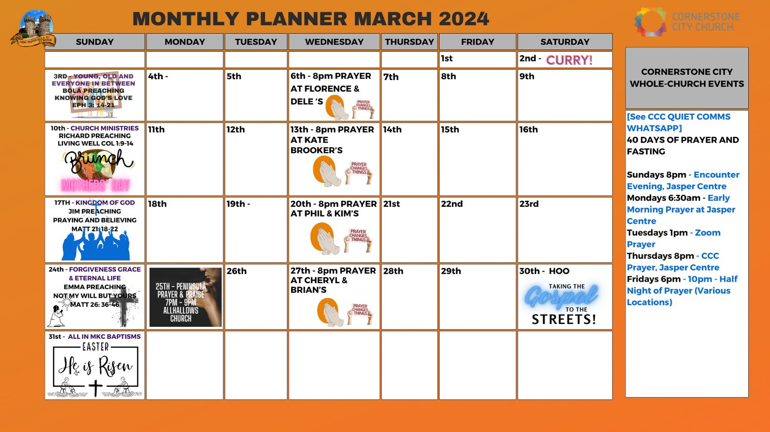

Slide 39
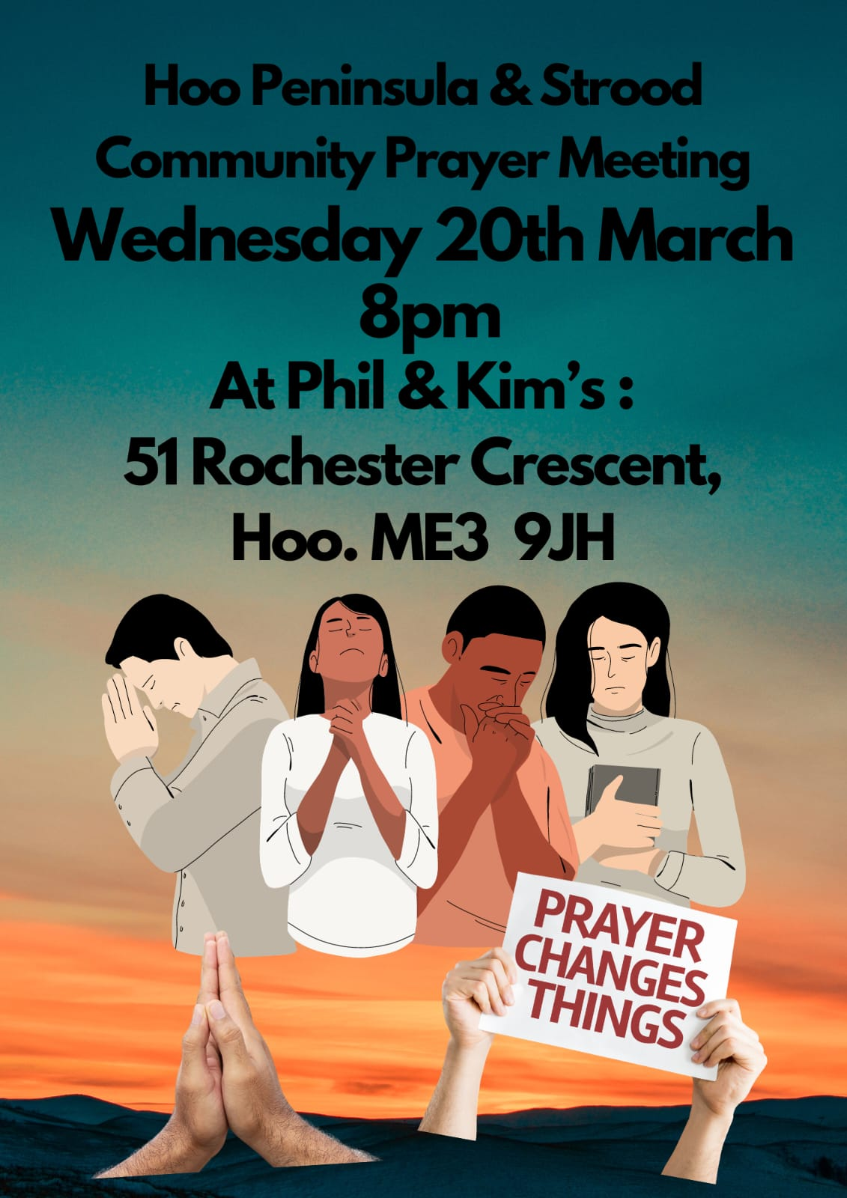

Slide 40


Slide 41


Slide 42


Slide 43


Slide 45


Slide 46


Slide 47
You Laid Aside Your Majesty
CCLI Song # 78275
© 1985 Thankyou Music
For use solely with the SongSelect® Terms of Use. All rights reserved. www.ccli.com
Note: Reproduction of this sheet music requires a CCLI Music Reproduction Licence. Please report all copies.
CCLI Licence No. 33265

Slide 48
1/2
You laid aside Your majesty
Gave up everything for me
Suffered at the hands
Of those You had created
You took all my guilt and shame
When You died and rose again
Now today You reign
In heaven and earth exalted

Slide 49
2/2
I really want to worship You my Lord
You have won my heart and I am Yours
For ever and ever
I will love You
You are the only one who died for me
Gave Your life to set me free
So I lift my voice to You
In adoration

Slide 51
2 Corinthians 14 May the grace of the Lord Jesus Christ, and the love of God, and the fellowship of the Holy Spirit be with you all

